Slide 1

JAVA AGENDA FOR THE SESSION
INHERITANCE
SUPER & FINAL KEYWORDS
ABSTRACTION
ENCSAPSULATION
POLYMORPHISM
ABSTRACT CLASS & INTERFACE

Slide 2

JAVA LEARNING ROADMAP
JAVA
JAVA
Inheritance
Types of inheritance
Super keyword
Final keyword
Abstraction
Encapsulation
Encapsulation
Polymorphism
Abstract Class
Interface

Slide 3
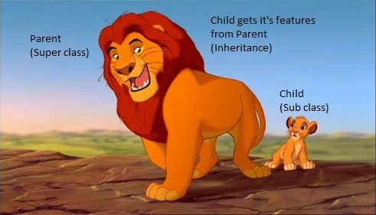
INHERITANCE

Slide 4
INHERITANCE
Inheritance is the process by which objects of one class acquire some properties of objects of another class.
The idea of inheritance provides the concept of reusability.
Types of inheritance
1)single
2)multilevel
3)multiple
4)Hierarchical 5)Hybrid

Slide 5
SUPER KEYWORD
To call super class variable if both super and sub class contains same variables.
To call super class method if both super and sub class contains same method.
To call super class parameterized constructor.

Slide 6
FINAL KEYWORD
Final variable value cannot be modified.
Final methods cannot be inherited.
Final classes cannot be extended.

Slide 7
ABSTRACTION
Abstraction is a process of hiding the implementation details from the end user,only the functionality will be provided to the end user.
In java abstraction is achieved through abstract classes and interfaces.

Slide 8
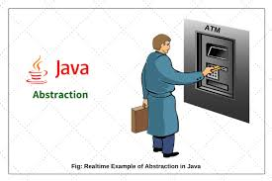
ABSTRACTION

Slide 9
ENCAPSULATION
Encapsulation is the process of binding data members and member functions in a single unit.
Encapsulation is achieved through class concept.
The whole idea behind encapsulation is to hide the implementation details from users.
If a data member is private it means it can only be accessed within the class. No outside class can access private data member.
However if we setup public setter and getter methods to update and read the private data fields then the outside class can access private data fields through public methods.

Slide 10
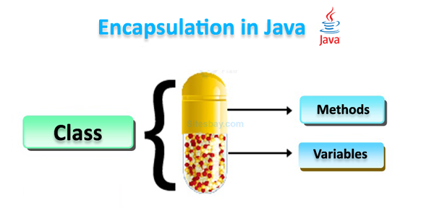
ENCAPSULATION

Slide 11
POLYMORPHISM
Polymorphism allows us to perform a single action with different ways.
Types of polymorphism
1) compile time polymorphism
2) runtime polymorphism

Slide 12
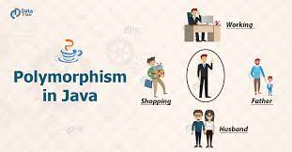
POLYMORPHISM

Slide 13
OVERLOADING
Method overloading which allows the methods to have a similar name but with the difference in signature.
Method overloading in java supports compile-time(Static) polymorphism.
Overloading rules:
1) Number of arguments
2) Type of arguments
3) Order of arguments

Slide 14
OVERRIDING
Method overriding is simply the redefining of the parent class method in the child class.
The name of the method remains same.
Static methods in java are non-overridable.

Slide 15
ABSTRACT CLASS
An abstract class is the class which is declared abstract and can have abstract or non-abstract methods.
An abstract class cannot be instantiated.
It can be extended by subclasses to implement abstract methods and either use or override concrete methods.
Abstract method is the method which do not have implementation i,e it does not have any body.
We can declare abstract class with all concrete methods.

Slide 16
INTERFACE
An interface is similar to a class.
It contains collection of abstract methods.
Interface methods are by default abstract methods.
Interface fields are by default public static final variables.
You cannot instantiate an interface.
An interface can be implemented by subclass.
An interface can be extends by multiple interfaces.

